Slide 1



8. One Function of Two Random Variables
Given two random variables X and Y and a function g(x,y), we form a new random variable Z as
Given the joint p.d.f how does one obtain the p.d.f of Z ? Problems of this type are of interest from a practical standpoint. For example, a receiver output signal usually consists of the desired signal buried in noise, and the above formulation in that case reduces to Z = X + Y.
(8-1)
PILLAI

Slide 2






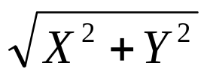


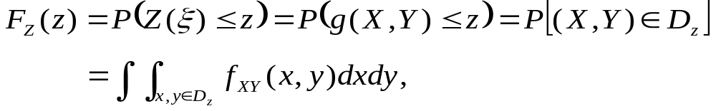
It is important to know the statistics of the incoming signal for proper receiver design. In this context, we shall analyze problems of the following type:
Referring back to (8-1), to start with
(8-2)
(8-3)
PILLAI

Slide 3





where in the XY plane represents the region such that is satisfied. Note that need not be simply connected (Fig. 8.1). From (8-3), to determine it is enough to find the region for every z, and then evaluate the integral there.
We shall illustrate this method through various examples.
Fig. 8.1
PILLAI

Slide 4

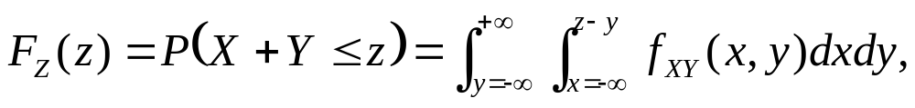







Example 8.1: Z = X + Y. Find Solution:
since the region of the xy plane where is the shaded area in Fig. 8.2 to the left of the line Integrating over the horizontal strip along the x-axis first (inner integral) followed by sliding that strip along the y-axis from to (outer integral) we cover the entire shaded area.
(8-4)
Fig. 8.2
PILLAI

Slide 5

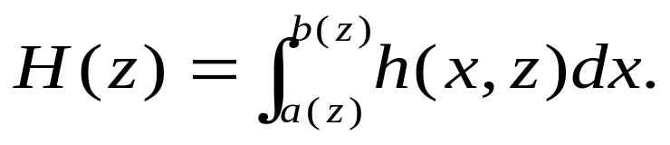
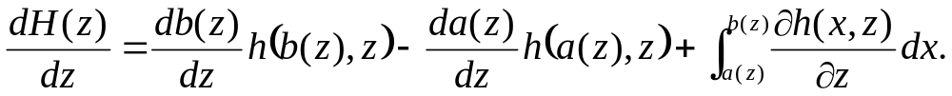
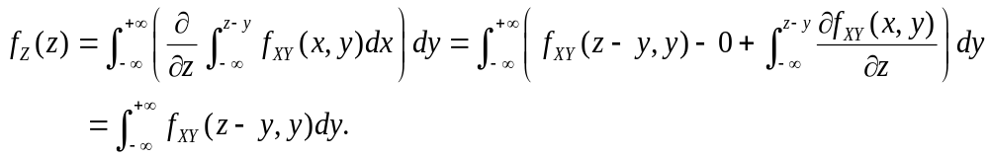
We can find by differentiating directly. In this context, it is useful to recall the differentiation rule in (7-15) - (7-16) due to Leibnitz. Suppose
Then
Using (8-6) in (8-4) we get
Alternatively, the integration in (8-4) can be carried out first along the y-axis followed by the x-axis as in Fig. 8.3.
(8-5)
(8-6)
(8-7)
PILLAI

Slide 6
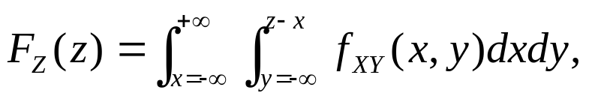

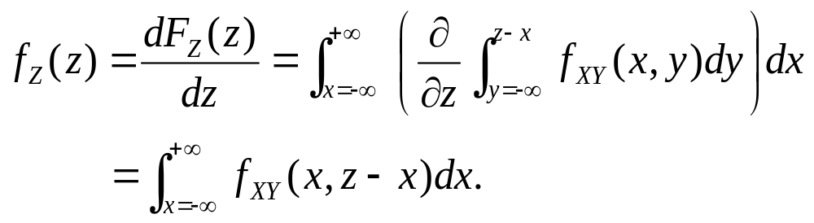

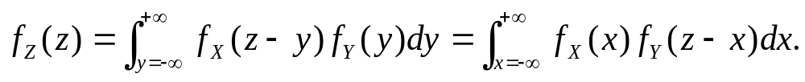
In that case
and differentiation of (8-8) gives
(8-8)
(8-9)
Fig. 8.3
If X and Y are independent, then
and inserting (8-10) into (8-8) and (8-9), we get
(8-10)
(8-11)
PILLAI

Slide 7









The above integral is the standard convolution of the functions and expressed two different ways. We thus reach the following conclusion: If two r.vs are independent, then the density of their sum equals the convolution of their density functions.
As a special case, suppose that for and for then we can make use of Fig. 8.4 to determine the new limits for
Fig. 8.4
PILLAI

Slide 8
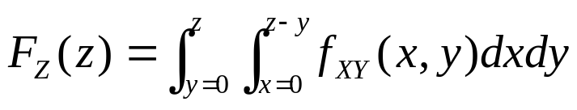
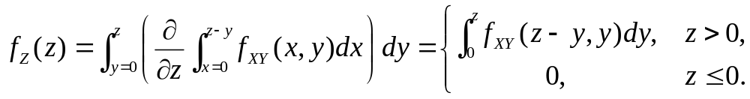
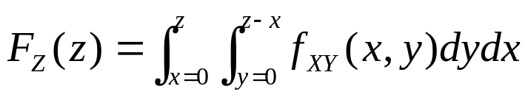
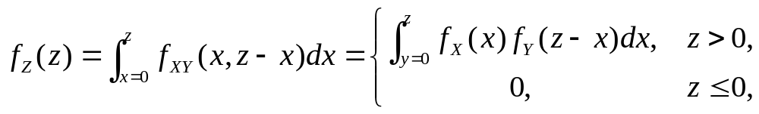
In that case
or
On the other hand, by considering vertical strips first in Fig. 8.4, we get
or
if X and Y are independent random variables.
(8-12)
(8-13)
PILLAI

Slide 9

Example 8.2: Suppose X and Y are independent exponential r.vs with common parameter λ, and let Z = X + Y. Determine Solution: We have and we can make use of (13) to obtain the p.d.f of Z = X + Y.
As the next example shows, care should be taken in using the convolution formula for r.vs with finite range.
Example 8.3: X and Y are independent uniform r.vs in the common interval (0,1). Determine where Z = X + Y. Solution: Clearly, here, and as Fig. 8.5 shows there are two cases of z for which the shaded areas are quite different in shape and they should be considered separately.
(8-14)
(8-15)
PILLAI

Slide 10




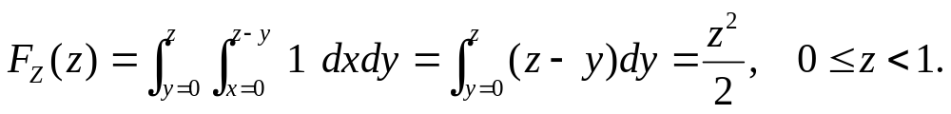

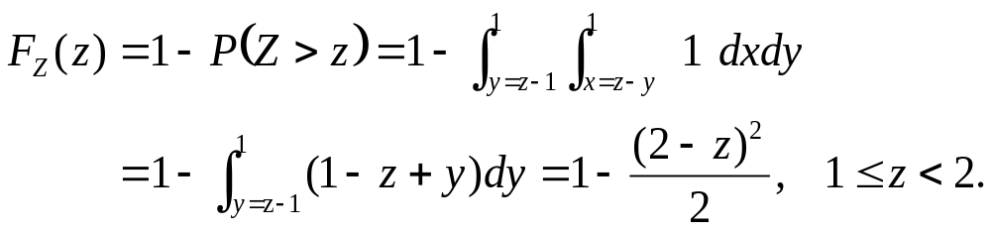
Fig. 8.5
For
For notice that it is easy to deal with the unshaded region. In that case
(8-16)
(8-17)
PILLAI

Slide 11
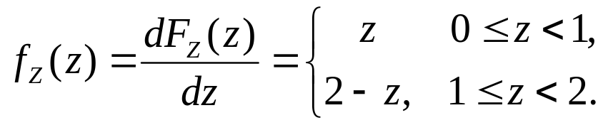



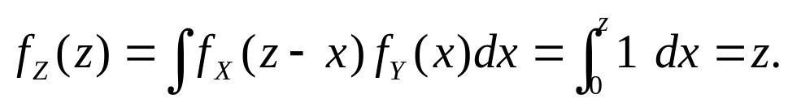

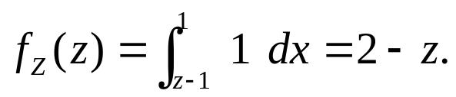
Using (8-16) - (8-17), we obtain
By direct convolution of and we obtain the same result as above. In fact, for (Fig. 8.6(a))
and for (Fig. 8.6(b))
Fig 8.6 (c) shows which agrees with the convolution of two rectangular waveforms as well.
(8-18)
(8-19)
(8-20)
PILLAI

Slide 12










Fig. 8.6 (c)
PILLAI

Slide 13

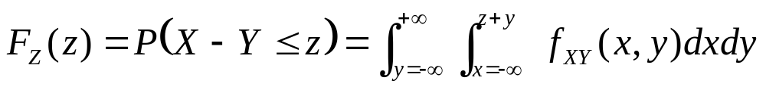
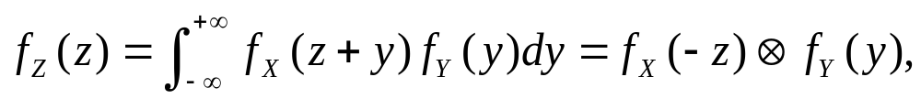





Example 8.3: Let Determine its p.d.f
Solution: From (8-3) and Fig. 8.7
and hence
If X and Y are independent, then the above formula reduces to
which represents the convolution of with
(8-21)
(8-22)
Fig. 8.7
PILLAI

Slide 14



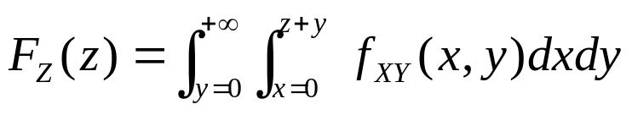



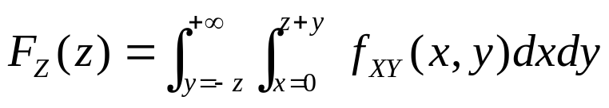
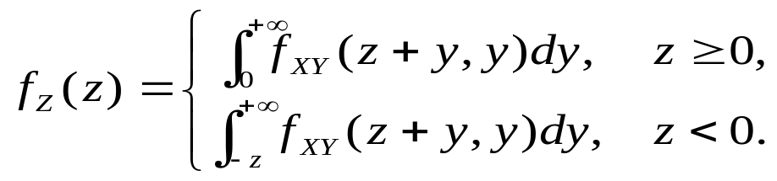
As a special case, suppose
In this case, Z can be negative as well as positive, and that gives rise to two situations that should be analyzed separately, since the region of integration for and are quite different. For from Fig. 8.8 (a)
and for from Fig 8.8 (b)
After differentiation, this gives
(a)
(8-23)
Fig. 8.8 (b)
PILLAI

Slide 15









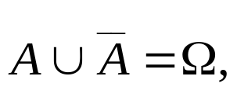
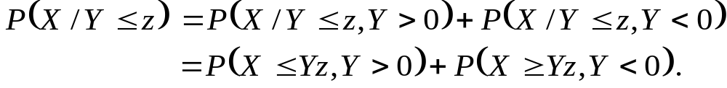

Example 8.4: Given Z = X / Y, obtain its density function. Solution: We have The inequality can be rewritten as if and if Hence the event in (8-24) need to be conditioned by the event and its compliment Since by the partition theorem, we have
and hence by the mutually exclusive property of the later two events
Fig. 8.9(a) shows the area corresponding to the first term, and Fig. 8.9(b) shows that corresponding to the second term in (8-25).
(8-24)
(8-25)
(a)
Fig. 8.9
(b)
PILLAI

Slide 16
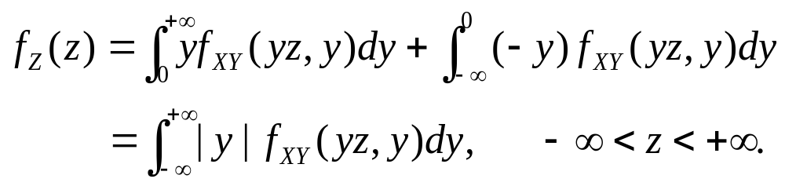
Integrating over these two regions, we get
Differentiation with respect to z gives
Note that if X and Y are nonnegative random variables, then the area of integration reduces to that shown in Fig. 8.10.
(8-26)
(8-27)
Fig. 8.10
PILLAI

Slide 17
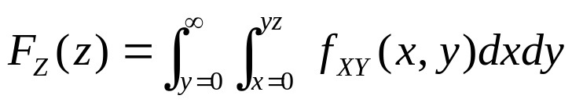
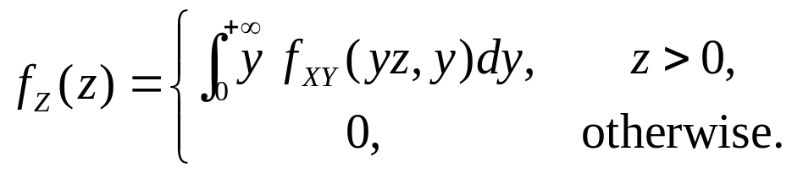
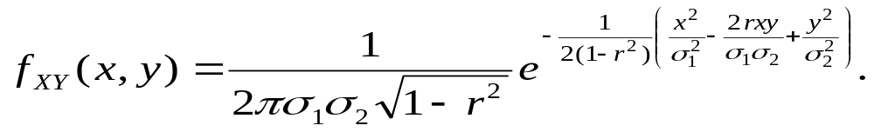


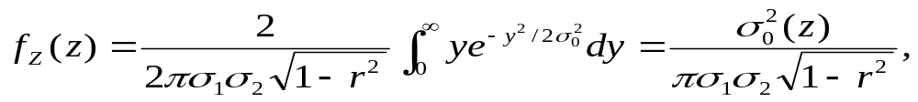
This gives
or
Example 8.5: X and Y are jointly normal random variables with zero mean so that
Show that the ratio Z = X / Y has a Cauchy density function centered at Solution: Inserting (8-29) into (8-27) and using the fact that we obtain
(8-28)
(8-29)
PILLAI

Slide 18
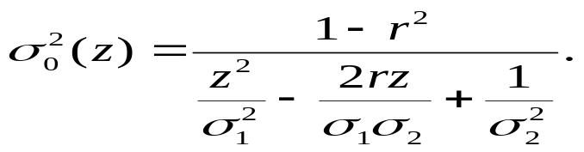
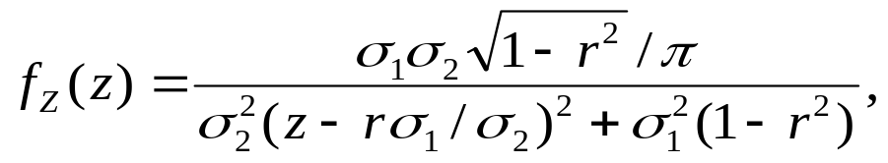
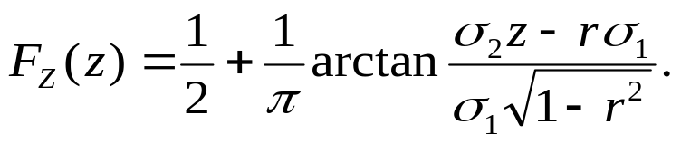

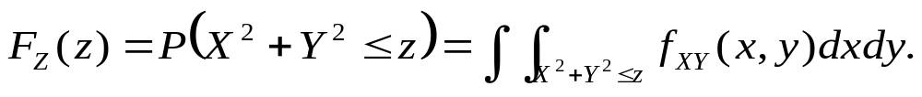
where
Thus
which represents a Cauchy r.v centered at Integrating (8-30) from to z, we obtain the corresponding distribution function to be
Example 8.6: Obtain Solution: We have
(8-30)
(8-31)
(8-32)
PILLAI

Slide 19


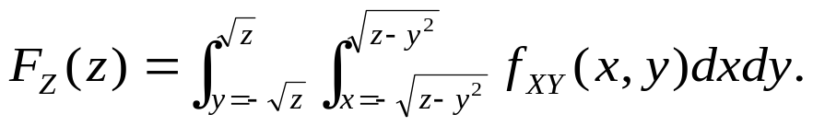
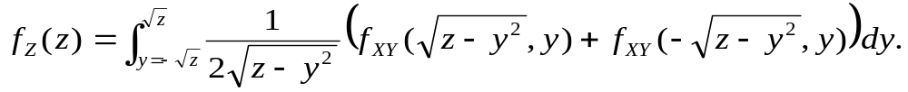



But, represents the area of a circle with radius and hence from Fig. 8.11,
This gives after repeated differentiation
As an illustration, consider the next example.
(8-33)
(8-34)
Fig. 8.11
PILLAI

Slide 20


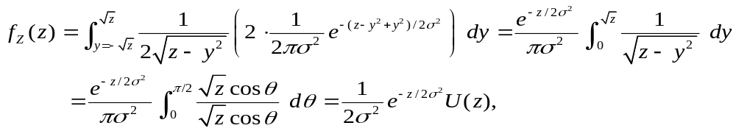






Example 8.7 : X and Y are independent normal r.vs with zero
Mean and common variance Determine for
Solution: Direct substitution of (8-29) with
Into (8-34) gives
where we have used the substitution From (8-35)
we have the following result: If X and Y are independent zero
mean Gaussian r.vs with common variance then
is an exponential r.vs with parameter
Example 8.8 : Let Find
Solution: From Fig. 8.11, the present case corresponds to a
circle with radius Thus
(8-35)
PILLAI

Slide 21
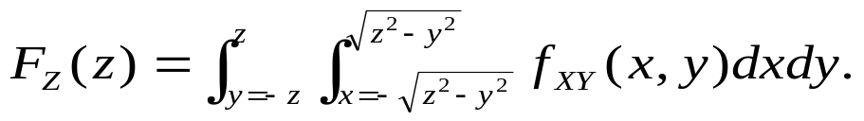
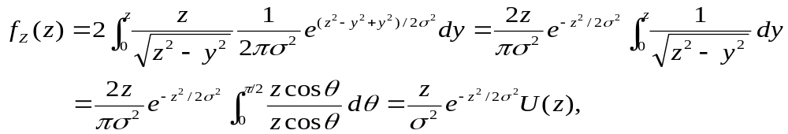


And by repeated differentiation, we obtain
Now suppose X and Y are independent Gaussian as in Example 8.7. In that case, (8-36) simplifies to
which represents a Rayleigh distribution. Thus, if where X and Y are real, independent normal r.vs with zero mean and equal variance, then the r.v has a Rayleigh density. W is said to be a complex Gaussian r.v with zero mean, whose real and imaginary parts are independent r.vs. From (8-37), we have seen that its magnitude has Rayleigh distribution.
(8-36)
(8-37)
PILLAI

Slide 22
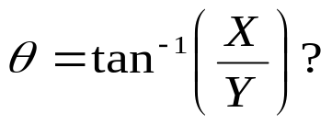



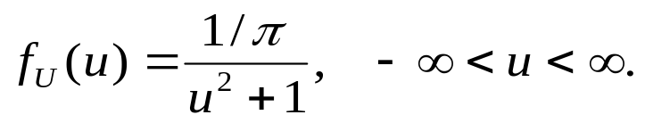
What about its phase
Clearly, the principal value of θ lies in the interval If we let then from example 8.5, U has a Cauchy distribution with (see (8-30) with )
As a result
To summarize, the magnitude and phase of a zero mean complex Gaussian r.v has Rayleigh and uniform distributions respectively. Interestingly, as we will show later, these two derived r.vs are also independent of each other!
(8-38)
(8-39)
(8-40)
PILLAI

Slide 23



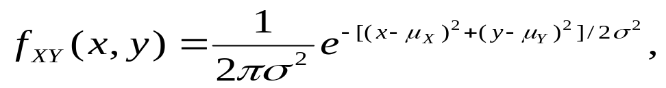


Let us reconsider example 8.8 where X and Y have nonzero means and respectively. Then is said to be a Rician r.v. Such a scene arises in fading multipath situation where there is a dominant constant component (mean) in addition to a zero mean Gaussian r.v. The constant component may be the line of sight signal and the zero mean Gaussian r.v part could be due to random multipath components adding up incoherently (see diagram below). The envelope of such a signal is said to have a Rician p.d.f.
Example 8.9: Redo example 8.8, where X and Y have nonzero means and respectively. Solution: Since
substituting this into (8-36) and letting
Multipath/Gaussian noise
Line of sight signal (constant)
Rician Output
PILLAI

Slide 24
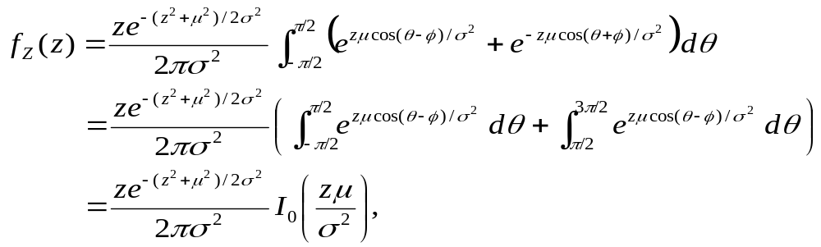
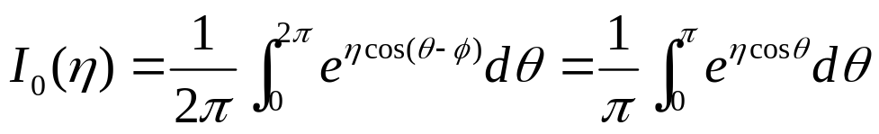

we get the Rician probability density function to be
where
is the modified Bessel function of the first kind and zero^{th} order.
Example 8.10: Determine Solution: The functions max and min are nonlinear
(8-41)
(8-42)
PILLAI

Slide 25











operators and represent special cases of the more general order statistics. In general, given any n-tuple we can arrange them in an increasing order of magnitude such that
where and is the second smallest value among and finally If represent r.vs, the function that takes on the value in each possible sequence is known as the k-th order statistic. represent the set of order statistics among n random variables. In this context
represents the range, and when n = 2, we have the max and min statistics.
(8-43)
(8-44)
PILLAI

Slide 26
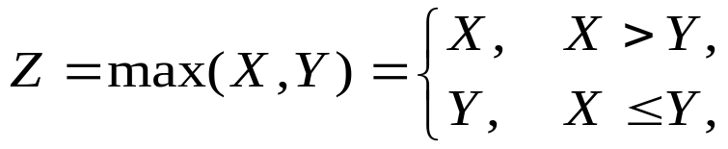















Returning back to that problem, since
we have (see also (8-25))
since and are mutually exclusive sets that form a partition. Figs 8.12 (a)-(b) show the regions satisfying the corresponding inequalities in each term above.
(8-45)
Fig. 8.12
PILLAI

Slide 27

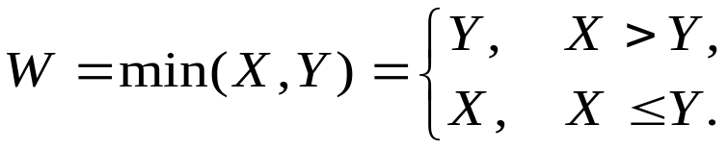
Fig. 8.12 (c) represents the total region, and from there
If X and Y are independent, then
and hence
Similarly
Thus
(8-46)
(8-47)
(8-48)
PILLAI

Slide 28



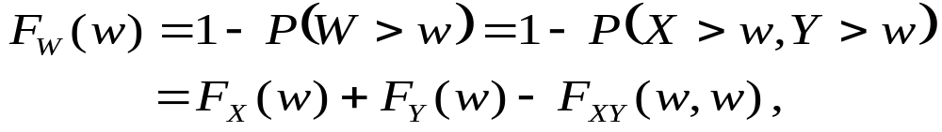


Once again, the shaded areas in Fig. 8.13 (a)-(b) show the regions satisfying the above inequalities and Fig 8.13 (c) shows the overall region.
(a)
(b)
(c)
Fig. 8.13
From Fig. 8.13 (c),
where we have made use of (7-5) and (7-12) with and
(8-49)
PILLAI

Slide 29





Example 8.11: Let X and Y be independent exponential r.vs with common parameter λ. Define Find Solution: From (8-49)
and hence
But and so that
Thus min ( X, Y ) is also exponential with parameter 2λ.
Example 8.12: Suppose X and Y are as give in the above example. Define Determine
(8-50)
PILLAI

Slide 30

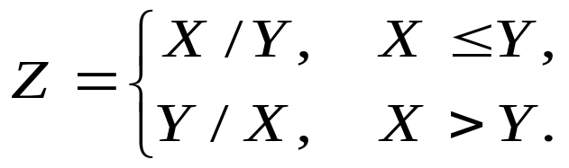
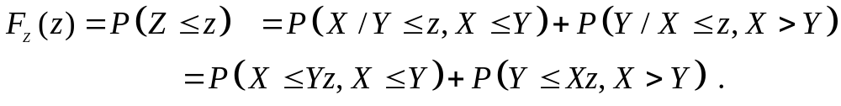


Solution: Although represents a complicated function, by partitioning the whole space as before, it is possible to simplify this function. In fact
As before, this gives
Since X and Y are both positive random variables in this case, we have The shaded regions in Figs 8.14 (a)-(b) represent the two terms in the above sum.
(8-51)
(8-52)
(a)
(b)
Fig. 8.14
PILLAI

Slide 31
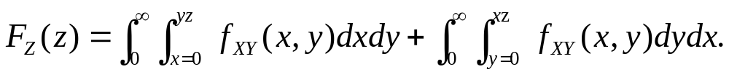





From Fig. 8.14
Hence
Example 8.13 (Discrete Case): Let X and Y be independent Poisson random variables with parameters and respectively. Let Determine the p.m.f of Z.
(8-53)
(8-54)
Fig. 8.15
PILLAI

Slide 32







Solution: Since X and Y both take integer values the same is true for Z. For any gives only a finite number of options for X and Y. In fact, if X = 0, then Y must be n; if X = 1, then Y must be n-1, etc. Thus the event is the union of (n + 1) mutually exclusive events given by
As a result
If X and Y are also independent, then
and hence
(8-55)
(8-56)
PILLAI

Slide 33


(8-57)
Thus Z represents a Poisson random variable with parameter indicating that sum of independent Poisson random variables is also a Poisson random variable whose parameter is the sum of the parameters of the original random variables.
As the last example illustrates, the above procedure for determining the p.m.f of functions of discrete random variables is somewhat tedious. As we shall see in Lecture 10, the joint characteristic function can be used in this context to solve problems of this type in an easier fashion.
PILLAI

